Slide 1
Essential facts to be derived from successful analysis of the premature failure of a weld fabricated oil rig structure and the subsequent lessons to be learnt.
The objective of this short lecture is to show how the true cause of failure can be determined and therefore deduce the lessons needed to be learnt.
A lecture given by DR E. J. France --- M.WELD.I --- FIMMM --- C.Eng.

Slide 2
A PHILOSOPHICAL POINT TO BE MADE WITH REGARD TO FAILED WELD FABRICATED STRUCTURES.
Welded structures are assigned a function.
The Alexander L. Kielland (ALK) Oil Rig / Platform to be used as our example of a welded structure that failed, originally was assigned to function as a drilling rig and subsequently a floating hotel.
The philosophical point to be made here is that for the ALK rig / platform to function for its designated design lifetime it must be weld fabricated in a “correct manner”, therefore, the welding engineering action, i.e. the application of the welding processes to the joints, becomes most critical.
It follows therefore, that application of welding processes to construct these structures must be done under control, which means qualified welding procedure should and must be used. --- FACT !

Slide 3
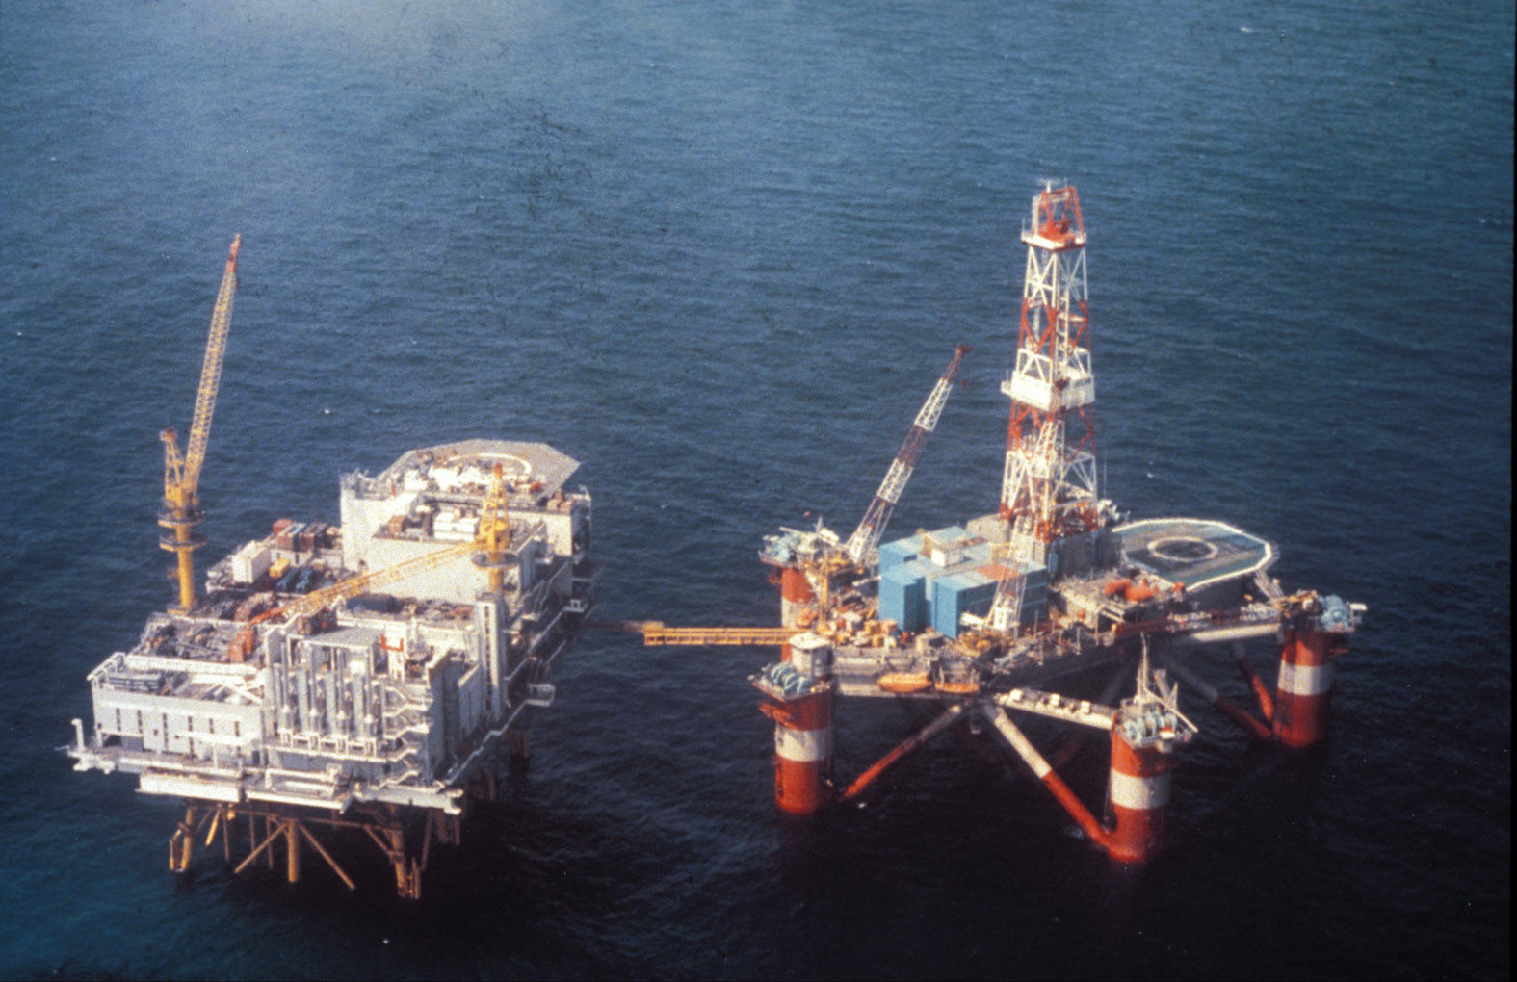
The Alexander L. Kielland Oil Platform / rig , a pentagonal designed structure, in position in the North Sea, it appears to be in a satisfactory condition, however, it is already in a failed condition and will prematurely fail after 4.5 years in service.

Slide 4
How many pentagonal designed oil rigs were built and used during the 1960’s and onwards?
Answer : Not including the Alexander L. Kielland (ALK) rig, 11 as far as we know, 4 built in the French shipyard that built the ALK Rig.
All these 11 rigs worked for their design lifetime without catastrophic failure. One of these 11 rigs performed satisfactorily for 44 years. It can be concluded, therefore and quite safely, that these rigs were weld fabricated in accordance with their rig fabrication specification requirements.
The evidence to be observed regarding the ALK rig shows beyond all doubt and 100% indisputably, that this rig was not weld fabricated to the requirements of the rig fabrication specification. To observe catastrophic failure of the ALK rig should not present surprise, therefore.

Slide 5
A working definition of catastrophic failure of a welded component and or structure.
The working definition of a catastrophic failure to be used in this lecture / presentation is as follows :-
“ A catastrophic failure is where a welded component and or structure suffers premature lack of function in relation to is design life”.

Slide 6
The ultimate question for this lecture is :- Over the passing years, have the necessary lessons been learnt in the world-wide weld fabrication industry to reduce the chances of catastrophic failure ? --- Let us investigate, using our example of a premature welded structure failure !
The chosen example showing successful analysis, of premature failure of a welded structure is to be:- “The Catastrophic Collapse of the Alexander L. Kielland Oil Platform in the North Sea, 27th March, in1980.”
The fact that this incident happened in1980, does not pose a problem to finding the true cause of “collapse”, providing evidence still exists, whilst considering the fact we are now over 40 years later in time.
Question : Does the evidence remain in a form for successful failure analysis to be carried out, regarding the failure of the Alexander L. Kielland Oil Platform?
Answer : An emphatic YES !!

Slide 7
Question : If evidence relevant to finding the true cause of the Alexander L. Kielland Oil Platform was not available and or had been deliberately destroyed, could we be successful in a failure analysis exercise?
Answer to above question is :- Sadly No ! --- However ! Attempts were made by certain parties involved with the incident to suppress and or deliberately destroy evidence, fortunately these people were unsuccessful. --- This latter situation has facilitated failure analysis to be carried out by a professional.
The data required for the analysis was successfully collected by a commission appointed by Royal Decree on 28th March 1980, by the Norwegian Ministry of Justice and Police. --- Unfortunately, there was no person residing on the commission team, of the appropriate profession and experience, to accurately interpret the critical data collected. --- The commission did issue a formal report, however, the text contained seriously inaccurate welding engineering science and only served to mislead everyone involved with the incident.

Slide 8
Question : Was there any significant data in the commission report?
Answer to the above question : Yes ! --- This data was displayed and contained in diagrams and especially photographs of the wreckage, the wreckage that was towed into a fjord after the incident occurred. --- To an investigator of failure analysis of welded structure, like the author of this article, it was indeed fortunate that this data was available for analysis, as the commission report is really the only source of a major amount of data. --- There are, however, other sources of data.
Based upon an analysis of the data from the commission report the author was able to determine the true cause of failure of the Alexander L. Kielland (ALK) Oil Platform.

Slide 9
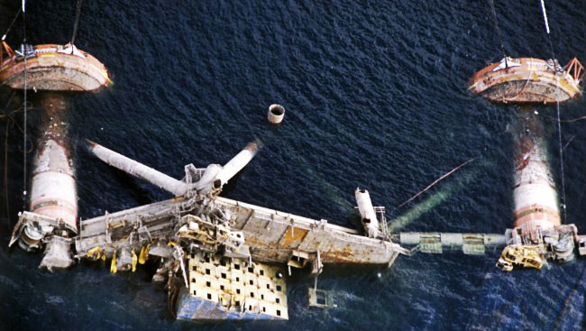
What was the data from the commission report that allowed the author to determine and find the true cause of the ALK Oil Platform failure?
Data : Upon macro view, there was no evidence of plastic deformation, i.e. overload. --- Reference the wreckage in the fjord, it shows no change of shape in component parts of the rig.

Slide 10
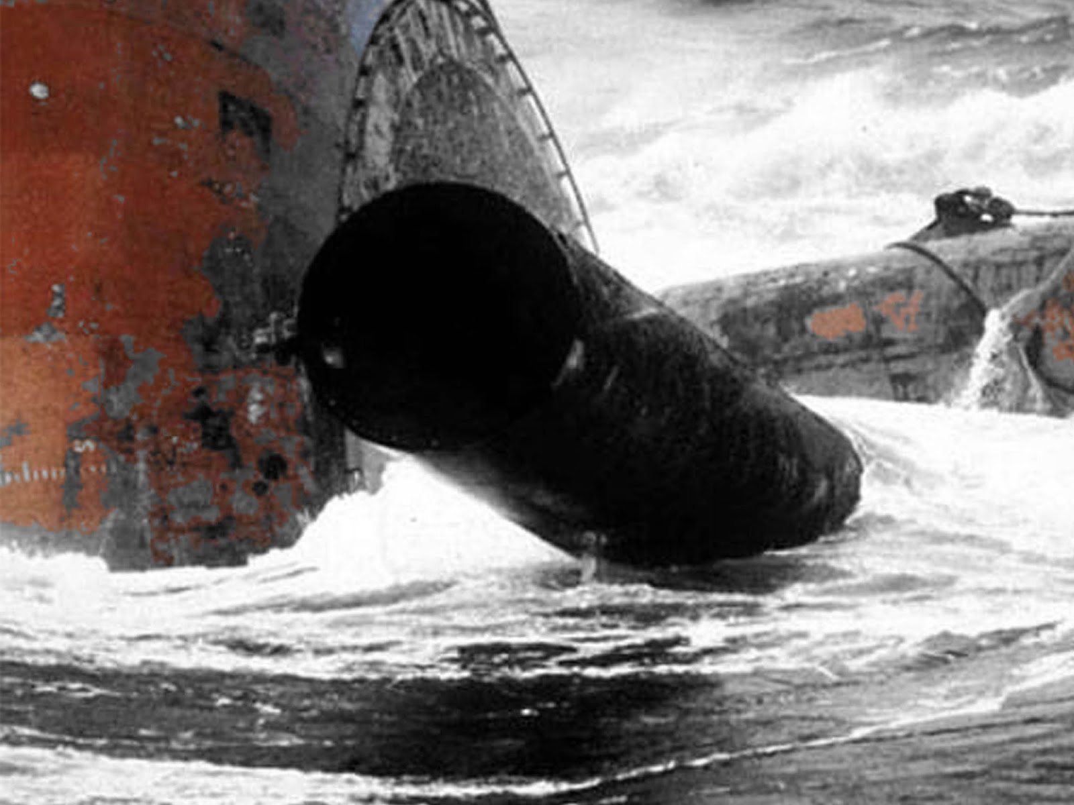
This photograph shows other features of the rig, a pontoon, rig leg and a rig brace that has fractured, yet still you do not observe change of shape in parts of the rig structure and therefore evidence of overload.

Slide 11
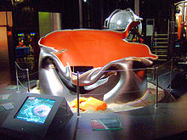
If the ALK Rig was overloaded what would the component parts of the structure look like upon failure?
Answer : - The component parts that were tubular in shape for example, would resemble a collapsing bean bag, the laws of physics say so, reference image below. Further, when the overload was to be experienced , collapse would be almost immediate whereas the ALK rig took 4.5 years to finally fail.

Slide 12
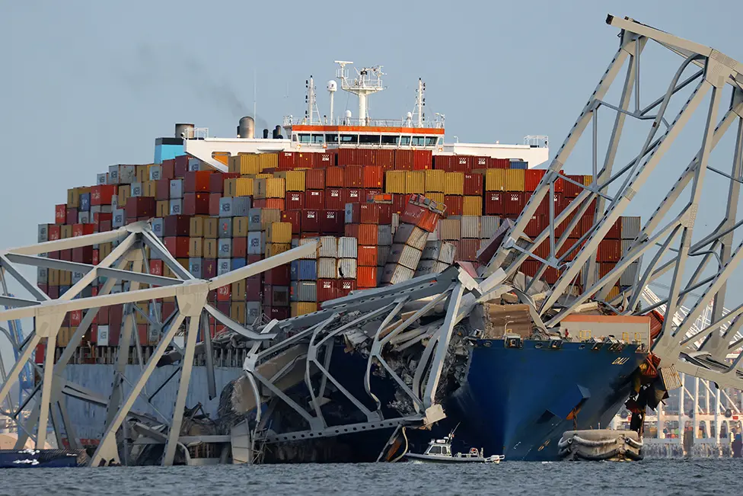
The Frances Scott bridge collapse , Baltimore, USA, in March 26th , 2024, showed evidence of overload. Time to failure was 40 seconds, i.e. virtually immediate the overload was experienced.

Slide 13
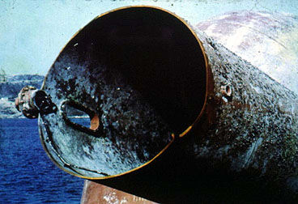
Close up macro view of an ALK brace, Brace D6, that had indeed fractured from the position of a hydrophone insert branch welded joint. Observe that the brace tubular shape is retained, therefore no plastic deformation , i.e. no evidence of overload.

Slide 14
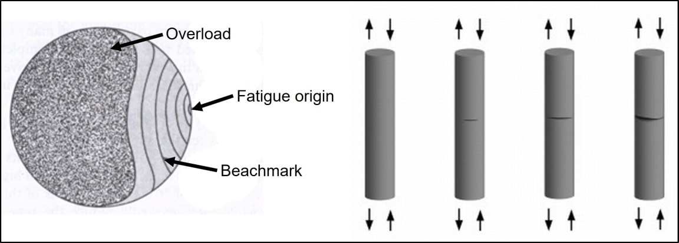
Observing the absence of overloading effects, the fact that the ALK rig took 4.5 years to fail is symptomatic of failure derived from fatigue crack propagation mechanisms coming into being , existing and operating.
Having determined that fatigue crack propagation mechanisms were operating they need a defective origin to come into being i.e. exist as a mechanism. This is a basic metallurgical fact one learns at University.

Slide 15
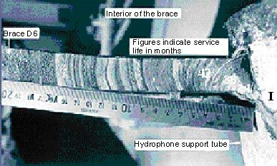
Concluding that there was no evidence of overload then the rig structure must have experienced fatigue behaviour. On Brace D6, for example, was there evidence of a fatigue crack propagation mechanism operating here?
Answer to the above question :- A definite YES ! The beach marks point back to the defective origin, the hydrophone fillet joint.

Slide 16
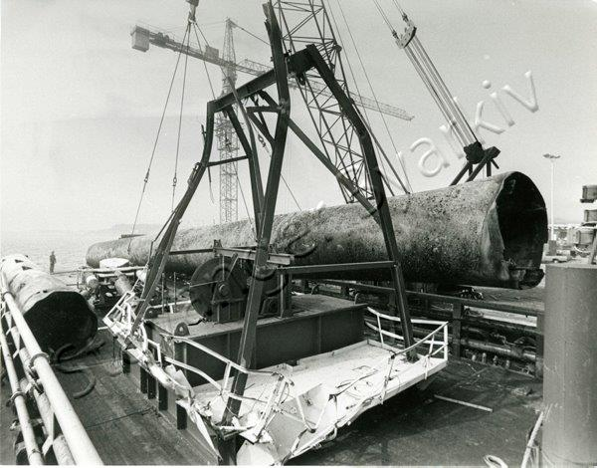
On the ALK rig / platform, which joints were suffering fatigue crack propagation mechanisms?
Most definitely on the hydrophone insert joint Brace D6 and to be observed on the joint connecting brace DE with legs D and E but there were other joints affected.
Brace D6 Brace DE

Slide 17
Shortly after the photograph of Brace DE was taken, what did the Norwegian authorities do ?
Answer : Brace DE when brought ashore was melted down to make more steel, in very short time! This particular action taken by the Norwegian investigation authorities deliberately destroyed what they thought was vital evidence as to the cause of the rig failure, but they were unsuccessful as the photograph tells the truth. Nowadays this type of action in the investigation of a catastrophic failure would be regarded as a criminal offence and not permitted.

Slide 18
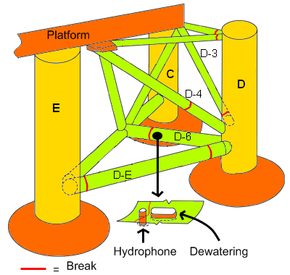
On the ALK Rig / Platform, in which position were those latter joints suffering fatigue crack propagation?
Answer : These joints are indicated by the red rings on the schematic diagram.

Slide 19
The official line / argument and explanation of the cause of failure by the Norwegian Authorities was that the first of these fatigue affected braces to fracture initiated the failure / collapse of the ALK Rig.
Due to the professional ignorance of the investigation commission, it was assumed that the true cause of collapse was fracture of these joints in the braces, to these naive people this would appear rather obvious!! However, ignorance is shown by the fact the investigators at the time of collapse did not ask the question : “ Where are the defective origins for the fatigue crack propagation mechanisms on these joints ?” We can find the truth regarding this question by further examination of the fractured Brace D6.
Where is the defective origin for the hydrophone welded joint on Brace D6?
The defective origin on brace D6 can be identified as the fillet welded joint on the hydrophone insert. Evidence derived from the image of its fracture surface and the macro sections taken from the hydrophone insert fillet remaining attached to the brace, confirms this fact.

Slide 20
Macro sections were taken from the remaining hydrophone fillet welded joint.
Three positions were indicated 85, 94 and 96 around the circumference. The macro sections are shown on the next slide. Notice the hydrogen induced cracking at position 85, this is the condition of the originally welded joint in the shipyard, 1976 it was in a “failed condition” then!

Slide 21
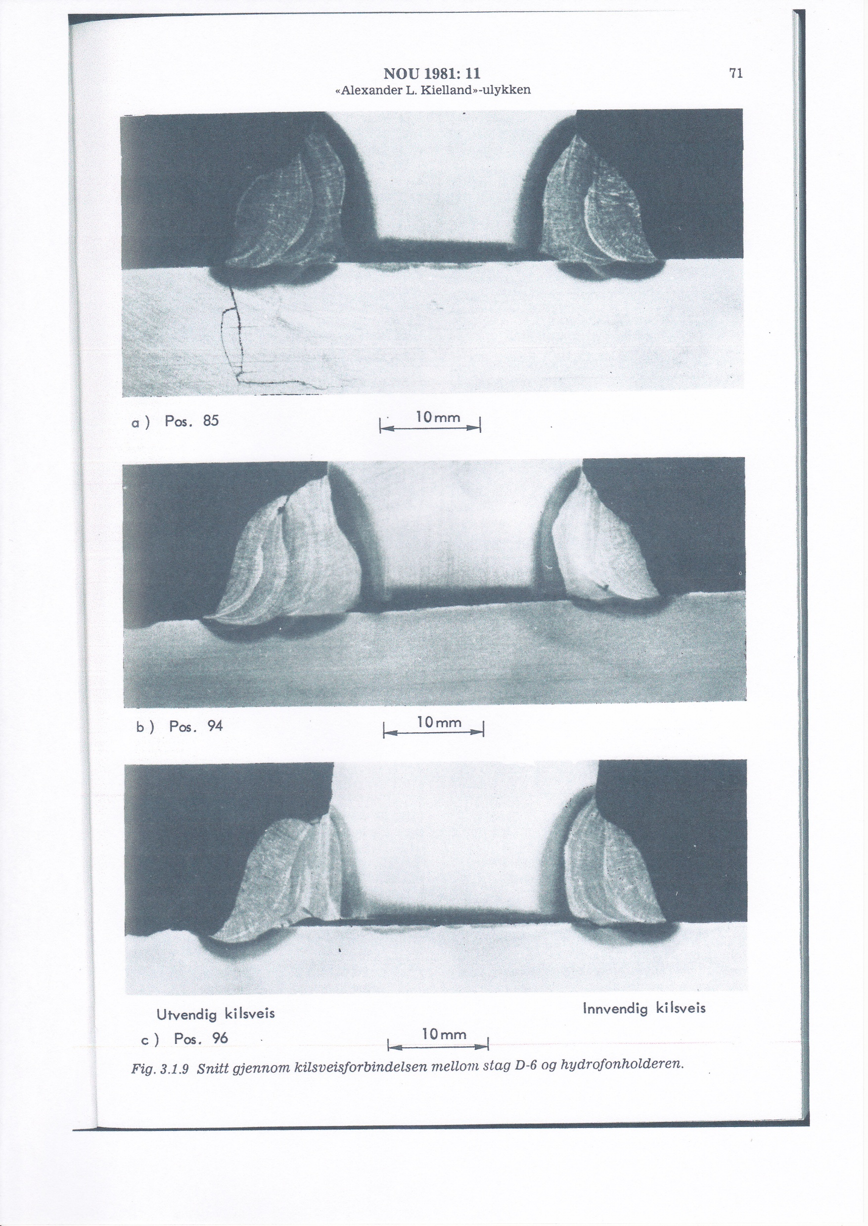

Slide 22
Interpretation of the hydrophone fillet welded joint macro sections.
At position 85 we observe a hydrogen induced crack emanating from the surface of the fillet weld and into the bulk of the insert tube. This crack has no association and is a distance away from the fatigue crack propagating mechanism position and so ! – what we are observing is the original weld produced in the French shipyard in 1976. This proves beyond all doubt that some of the welds on the rig remained in a cracked condition when the rig was towed into position in the North Sea. Welds with these features of cracking, are, by definition, in a “failed condition” as the atoms in a crack are not bonded. The other macro positions 94 and 96, prove also that the welders did not use a qualified weld procedure to produce the fillet joint. To use qualified weld procedures to weld joints on the ALK rig was a mandatary requirement of the rig specification Neptune 985A.

Slide 23
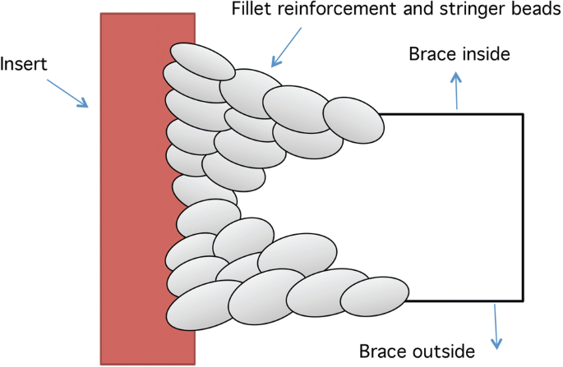
Was the fillet joint a correctly specified joint on Brace D6? Answer : No !! It should have been a full thickness joint with reinforcement to satisfy sound engineering principles.
By cutting a large hole in the brace D6, to accommodate the hydrophone insert pipe housing, one has removed load bearing steel area and so this area must be recovered by welding the joint full penetration with reinforcement , as indicated.

Slide 24
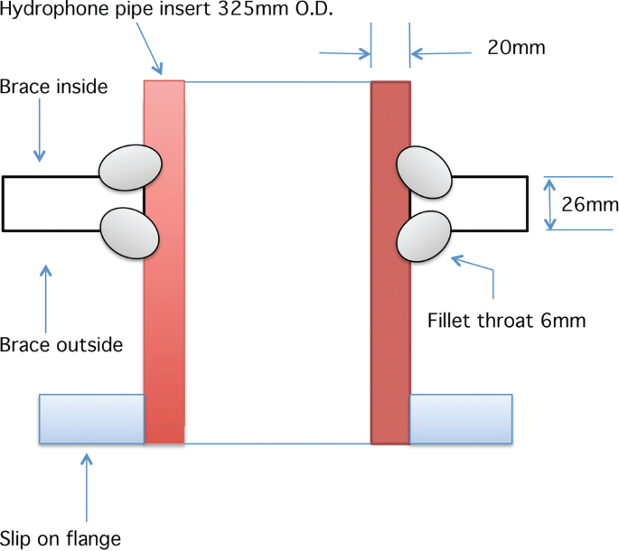
The detail of the incorrectly specified fillet joint on the hydrophone insert on Brace D6.

Slide 25
Additional evidence that reinforces the fact that some welds on the rig remained in a cracked condition when the rig was towed into position in the North Sea.
The commission found paint on the inside of the hydrophone fillet joint on Brace D6, there is only one way the paint could have been found in this position. The fillet joint on the hydrophone insert was defective with hydrogen induced cracks that emanated from the joint surface into the bulk of the steel product forms. The welded joint should have been repaired in accordance with the rig specification, Neptune 985 A, mandatary requirements.
With welded joints in this defective condition on the ALK Rig, i.e. with extensive cracking, a certificate of seaworthiness could not be given, such that the rig builders and owners could not obtain insurance for Rig service. --- It must therefore be concluded the rig was painted to hide this defectiveness to obtain the certificate of sea worthiness --- is this fraud ?

Slide 26
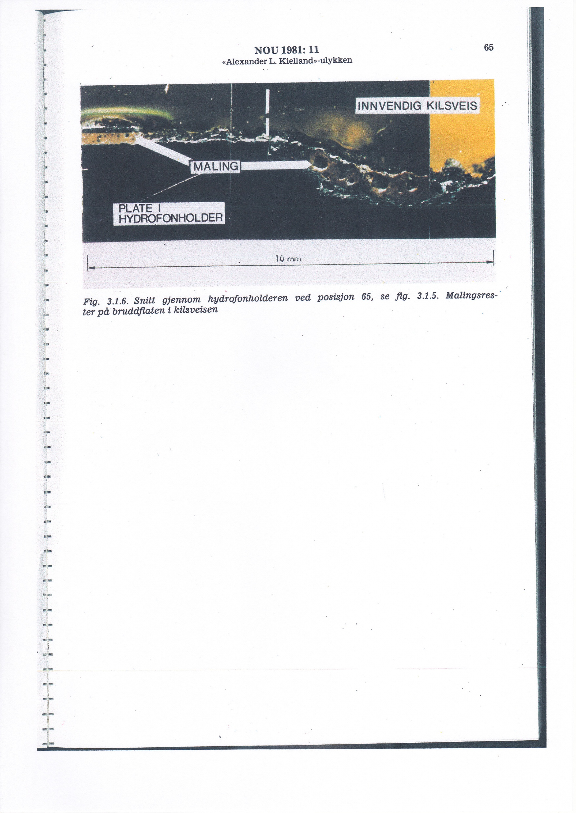
A section through the hydrophone insert joint showing paint on the fracture surface, i.e. inside the fillet weld. Note : “Maling” is the Norwegian word for paint.

Slide 27
Would the Alexander L. Kielland Oil Platform / Rig have failed if all the joints had been welded in accordance with the requirements of the rig fabrication specification, Neptune 985A.
Answer : No – to repeat, the rig would not have failed --- Proof, 100%, of this conclusion is the condition of the Drainhole, ( Dewatering hole ), which is only 270mm away and inline from the hydrophone insert joint, it is the same type of joint as the hydrophone insert joint, exposed to the same stresses and strains in service. Yet, there are no signs of any form of cracking or fracture. This is because the joint has been welded full thickness with reinforcement, using a “K” preparation, in accordance with qualified weld procedure. The procedure would and have contained all the measures needed to be taken to suppress any source for hydrogen induced cracking.

Slide 28
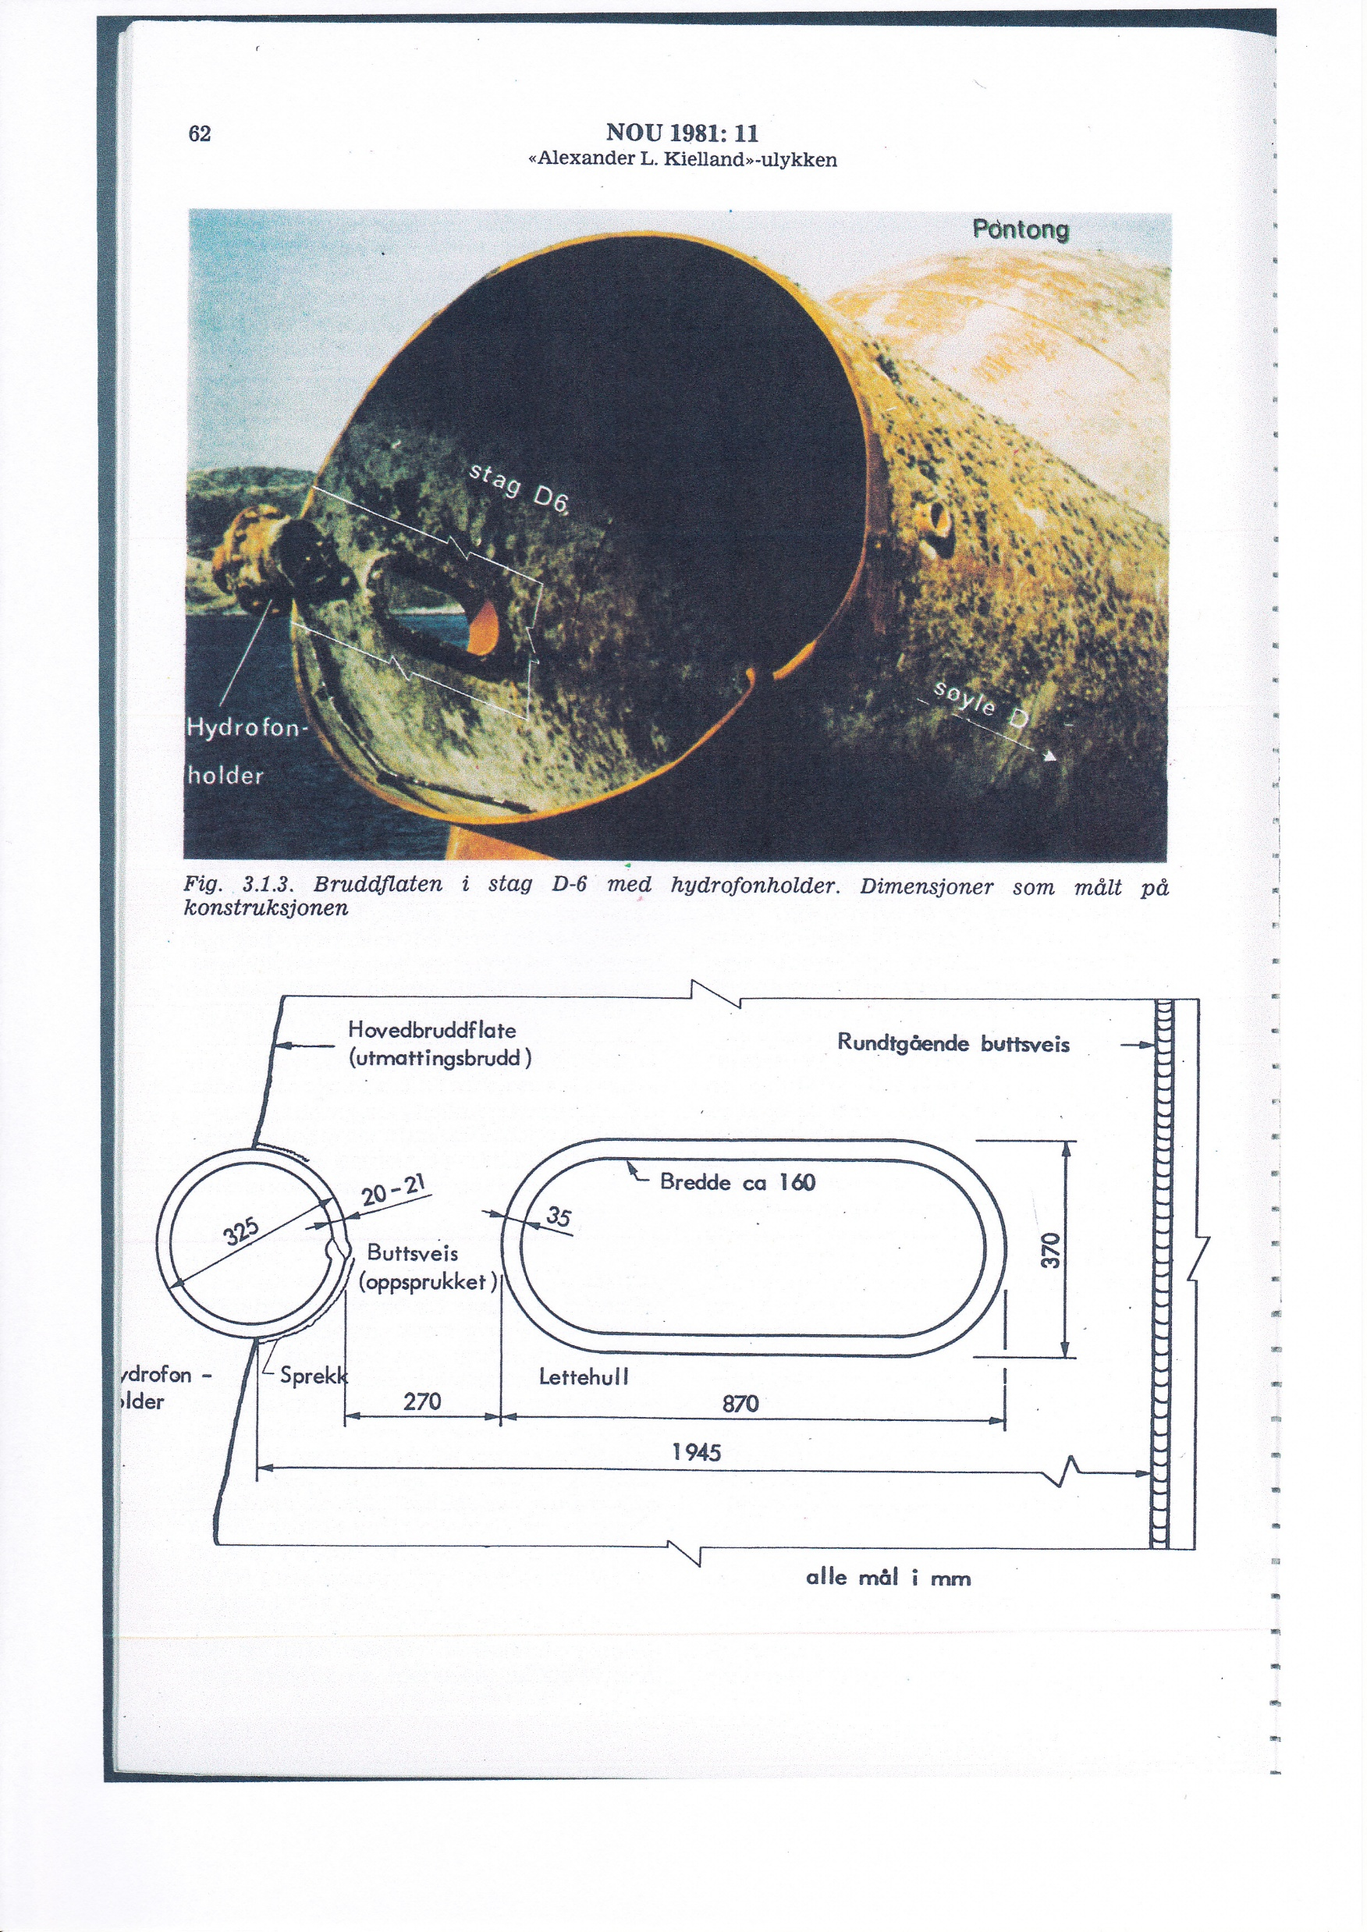
Drawings showing the position of the Drainhole ( Dewatering hole ) in relation to the hydrophone insert joint on Brace D6.

Slide 29
What are the main facts and lessons to be learnt, derived from this investigation and failure analysis into the collapse of the Alexander L. Kielland Oil Platform/Rig.
--- 1 --- Was there anything fundamentally wrong with the pentagonal design of the Alexander L. Kielland Oil Platform / Rig ? Answer: No --- Fact
The complete absence of plastic deformation of the steel of construction, provides 100% indisputable evidence that indicates that the rig was not overloaded at anytime, it was operating within the stresses expected and predicted by the design philosophy. The evidence is valid despite the rig suffering cracking in some of the “as welded” joints derived from the shipyard, in1976, e.g. on the hydrophone insert joint on Brace D6. The contention put forward by other investigators that the design was faulty because a leg fell off and caused instability of the rig, is beyond any credibility. Legs falling off other designed rigs, say, with more legs, will still cause instability. It all depends for satisfactory performance of a rig, is if it is welded correctly to its relevant fabrication specification.

Slide 30
Facts and lessons to be learnt continued ---
--- 2 --- There was a strongly held view that the Alexander L. Kielland Oil Platform / Rig was abused in various ways whilst in service. Does this conjecture have any foundation of truth ? Answer : No --- Fact
For this conjecture to have any foundation, in truth, the failed rig would have exhibited evidence of overload i.e. plastic deformation, followed by rapid physical collapse. There was no evidence to support the conjecture and so can be dismissed from consideration of the true cause of the rig failure.

Slide 31
Facts and lessons to be learnt continued ----
--- 3 --- Fact - The commission appointed by the Norwegian Ministry of Justice and Police did not contain on the team, an appropriate welding engineering professional who could have interpreted the data collected. For this reason alone, it is why the true cause of the “so called collapse” has never been known in Norway or anywhere else for that matter , up to and including the present day. Such is the effect of the scientific ignorance of welding engineering.
--- Lesson to be learnt:- Investigation teams put together to carry out failure analysis of welded structures, must include a welding engineer of some decades of experience in the welding fabrication industry. --- The welding engineer should be the leader for this type of an investigation, the leader certainly should not be a judge of the legal profession.

Slide 32
Facts and lessons to be learnt continued -----
--- 4 --- Fact – Judges , as proven by this ALK investigation, are for the sake of it, just data collectors, so much data is generated by these people that the true cause of the incident is buried and effectively lost. Therefore, it makes trying to find the true cause, like locating a needle in a haystack! This is why the true cause of the ALK Rig collapse was not originally detected until now.
--- Lesson to be learnt – Data collection, must be purposeful such that it can be followed to discover true cause of failure and certainly not carried in this manner of the ALK instance. To exemplify the principle of how failure investigations should be done is to mention the actions of forensic scientists who collect evidence / data from a crime scene. The forensic scientists follow where the data/evidence leads them.

Slide 33
Facts and lesson to be learnt continued -----
--- 5 --- Fact - The non-compliances, to the Neptune 985A rig specification requirements, exercised by the French shipyard, were deliberate, notably by applying welding processes to the joints of construction without reference to qualified weld procedure and using unqualified welders, with no relevant NDT. By todays standards this action would be classed as a criminal offence, corporate manslaughter in fact, as the action led to the unnecessary deaths of 123 people.
--- Lesson to be learnt – Quality assurance audits and certification of welding fabricators are no indicator that a welded fabrication resulting, will have the required quality to function for the designated design lifetime, i.e. if the fabricator management deliberately circumvent the contractual and specification requirements. Third party witness and inspection must be more potent.

Slide 34
What was and still is the official line and explanation of how the ALK rig failed ?
--- 6 --- Fact --- The official Norwegian authorities’ line and explanation of the cause of the ALK Oil Platform “so called” collapse, is based upon the rig being in an acceptable weld fabricated condition when it was towed into position in the middle of the North Sea - thus inferring that the cause was derived from naturally occurring, cracking propagation mechanisms, that became operational whilst the rig was in service. This suggestion has been proposed and seeks to absolve the shipyard from being the true origin of the cause of the failure, thereby diverting everyone from recognising who was to blame for the incident happening. --- Correct analysis of the evidence proves that this above conjecture is emphatically -- NOT TRUE !!

Slide 35
Facts and lessons to be learnt continued ------
--- 7 --- Fact - The true cause of the collapse of the ALK Rig originated from deliberately carried out, non-compliant welding practices applied to the welding of some of the joints in the French shipyard, in 1976, --- for example, the hydrophone insert fillet joint, that incurred serious and deleterious hydrogen induced cracking. This meant that the rig / platform was in a “failed condition” long before it was towed into working position in the North Sea.
--- Lesson to be learnt – To prevent this criminal behaviour by weld fabrication company management, the contractual fabrication specifications, quality assurance audit standards and “third party” weld inspection, must become more powerful and potent to control overall fabrication activity.

Slide 36
Facts and lessons to be learnt continued -----
--- 8 --- Fact – The ALK Rig did not collapse , strictly speaking, it capsized, a phenomenon derived from a “weld failed condition” in some of the joints, “as welded” in the French shipyard in1976. As time in service progressed in the North Sea, the ALK Rig showed at intervals, manifestations of this earlier failed weld condition in the form of fatigue crack propagation mechanisms, brace and leg fracture and 4 legged platform capsize. --- The ALK Rig, strictly to be correct from the welding engineering point of view, did not fail on 27th March 1980 in the North Sea but in the French shipyard, “as welded”, in 1976. --- The subtlety of this fact was lost to all investigators in Norway in 1980 and up to the present day, this ignorance with the truth is conveniently exploited by the cover up, certain corrupt individuals still alive today, the French shipyard, previous owners of the rig, third party inspection bodies/ companies and Norwegian politicians.

Slide 37
Facts and lessons to be learnt continued -----
--- 8 --- Lesson to be learnt – Tools we use to try and control weld fabrication, are up to this present day just simply not effective enough and must be toughened. The most potent weapon we have at our disposal should be implementation of corporate manslaughter law wherever possible in order to prosecute the responsible persons and companies.
Finally, the true cause of the ALK Oil Platform “so called collapse” on 27th March, 1980 has not been known, until now. --- In Norway and with other concerned parties involved, there is still much resistance to accepting the true cause of failure, due to their ignorance of welding engineering science, cover up , corruption and criminal behaviour.
To now finally answer the earlier question :- “ Have the necessary lessons been learnt in the world–wide weld fabrication industry, from examples of premature failure of welded structures ? --- Answer : SADLY NO !!

